Slide 1
ASP.NET Core MVC
By Jafar Muzeyin

Slide 2
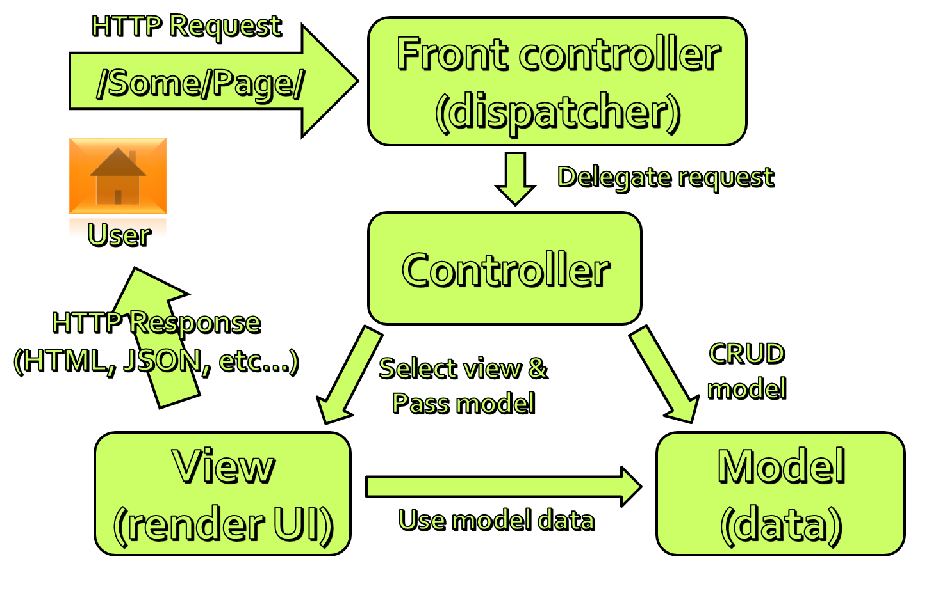
The MVC Pattern

Slide 3
Setting up MVC in Asp.net core
Step 1 : In ConfigureServices() method of the Startup class in Startup.cs file, include the following line.
services.AddMvc();
This line of code adds the required MVC services to the dependency injection container in asp.net core.
Step 2 : In the Configure() method, add UseMvcWithDefaultRoute() midddleware to the application's request processing pipeline

Slide 4
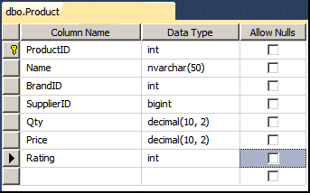
Model
Model in MVC contains a set of classes that represent data and the logic to manage that data
It is a c# class with properties and methods.
The model does not and should not depend on Controller or View.
The only responsibility of the model is to hold the data.
The model class is ideally reusable.
1 2 3 4 5 6 7 8 9 10 11 12 13 | public class Product { public int ProductId { get; set; } public string Name { get; set; } public Decimal Price { get; set; } public int Rating { get; set; } public Brand Brand { get; set; } public Supplier Supplier { get; set; } }

Slide 5
What is a Controller
The Controller is the first component to receive the request from the User.
When a user enters a URL into the browser, the ASP.NET Core MVC routing engine maps the request to a specific controller.
http://localhost/Home/Courses

Slide 6
The Controller Responsibilities
The Controller is responsible to Handle Request from the User.
The Controller Action method executes the application logic and builds a model
Send the Response
Finally, it should return the Result in HTML/File/Json/XML or whatever the format requested by the user.

Slide 7
Adding a Controller
By Convention, Controllers Reside in the project’s root-level Controllers folder.
You can create a Controller by selecting the Controllers folder and right-click and select the Controller
The Controllers in ASP.NET Core Inherit from controller class which in turn inherits from the ControllerBaseClass
The controller class must satisfy at least one of the following conditions
The class name is suffixed with “Controller”.
The class inherits from a class whose name is suffixed with “Controller”.
The class is decorated with the [Controller] attribute.

Slide 8
Action Method
Any Public method exposed by a Controller is called an Action method.
The Action method gets called when a user enters a particular URL in the browser.
Action methods should call the service layer to respond to the request. The Service layer generally should query or update the database using data access layer and then map the results into a model and pass it back to the Action method.
Action method then invokes the View with the model to generate the response.

Slide 9
Action Method
When Creating an Action method you should remember the following
Action methods Must be a public method
The Action method cannot be a Static method or an Extension method.
The Constructor, getter or setter cannot be used.
Inherited methods cannot be used as the Action method.
Action methods Cannot contain ref or out parameters.
Action Methods cannot contain the attribute [NonAction].
Action methods cannot be overloaded

Slide 10
Return Types
ViewResult – Represents HTML and markup.
EmptyResult – Represents no result.
RedirectResult – Represents a redirection to a new URL.
JsonResult – Represents a JavaScript Object Notation result that can be used in an AJAX application.
JavaScriptResult – Represents a JavaScript script.
ContentResult – Represents a text result.
FileContentResult – Represents a downloadable file (with the binary content).
FilePathResult – Represents a downloadable file (with a path).
FileStreamResult – Represents a downloadable file (with a file stream).

Slide 11
Routing

Slide 12
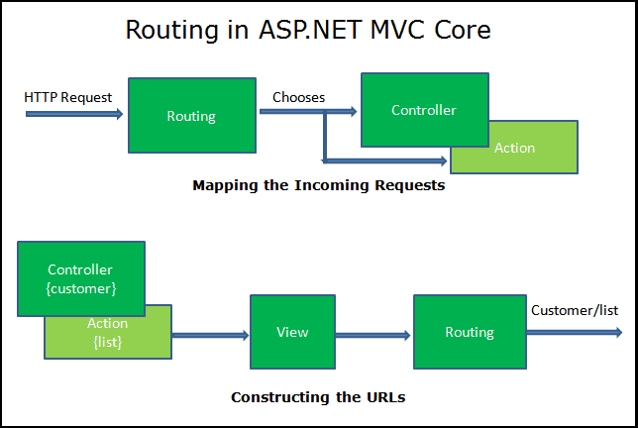
What is Routing
It maps the incoming requests to the Controller Action
Generate an outgoing URLs that correspond to Controller actions.

Slide 13
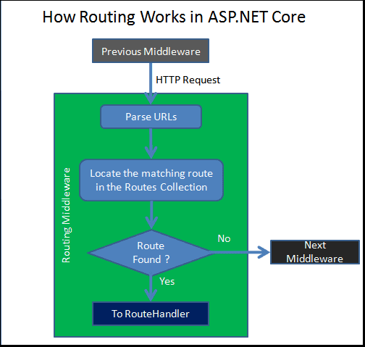
How Routing Works
It Parses the URL.
Searches for the Matching Route in the RouteCollection.
If the Route found then it passes the control to RouteHandler.
If Route not found, it gives up and invokes the next Middleware.

Slide 14
How to Set up Routes
There are two different ways to set up routes:
Convention-based routing
Attribute routing

Slide 15
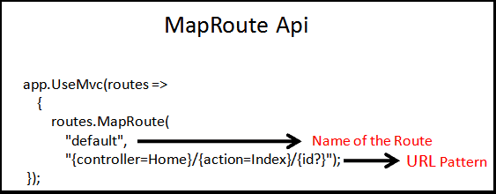
Convention Based Routing
The Convention based Routes are configured in the Configure method of the Startup class..
The Routing in is handled by the Router Middleware:
app.UseMVC
app.UseMvcWithDefaultRoute.
The app.UseMvc method gets an instance of the RouteBuilder class
The RouteBuilder has an extension method MapRoute which allows to add Route to the Routes Collection as shown on diagram.
In the above example, the MapRoute creates a single route, which is named as default and the URL Pattern of the route is {controller=Home}/{action=Index}/{id?}

Slide 16
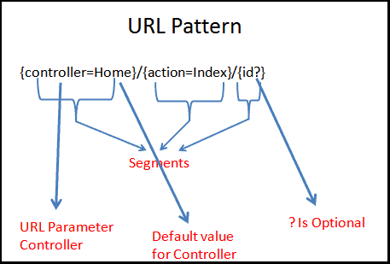
URL Patterns
The Each route must contain a URL pattern. This Pattern is compared to an incoming URL. If the pattern matches the URL, then it is used by the routing system to process that URL.
Each URL Pattern consists of one or more “segments.” The Segments are delimited by the forward slash character The Route Parameters are wrapped in curly braces for example {controller}, {action}.
The Route Parameters can have default value like {controller=Home}, where Home is the default value for the controller. An equals = sign followed by a value after the Route Parameter name defines a default value for the parameter
You can also have the Constant segments as shown in this route. admin/{controller=Home}/{action=Index}/{id?}. Here admin is a Constant and must present in the requested URL.
The ? in {id ?} indicates that it is optional. A question mark ? after the route parameter name defines the parameter as optional
The URL Pattern {controller=Home}/{action=Index}/{id?} Registers route where the first part of the URL is Controller, the second part is the action method to invoke on the controller. The third parameter is an additional data in the name of id.

Slide 17
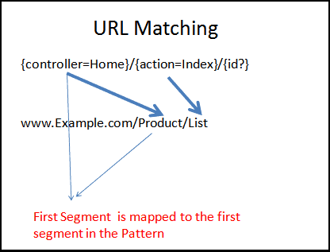
URL Matching
Each segment in the incoming URL is matched to the corresponding segment in the URL Pattern.Each URL Pattern.
The Route {controller=Home}/{action=Index}/{id?} has three segments. The last one is optional.
Consider the Example URL www.example.com/product/list. This URL has two segments. This URL Matches with the above pattern as the third segment in the URL Pattern is Optional.
The Routing engine will parse as {controller} = Product & {action}= List
The URL www.example.com/product also matches with the above URL Pattern, although it has only one segment. This is because the action placeholder has a default value of the Index. if there is no corresponding segments are in the URL and segment has a default value in the Pattern, then the default value is chosen by the Routing Engine.

Slide 18
Dependency Injection

Slide 19
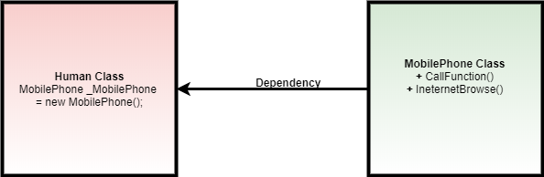
Dependency Injection
Dependency Injection (DI) is an Object-Oriented Programming(OOP) design pattern that allows us to confirm loosely coupled implementation in the application.
Suppose we have two pretty simple classes namely as Human class and MobilePhone class.
MobilePhone class has just CallFunction and InternetBrowse functionality.
Human class uses MobilePhone class functionality by creating new objects of class MobilePhone inside Human class.
As a result, the Human class completely depends on MobilePhone class.
Dependency Injection helps to remove the dependency on the other class by supplying the dependencies of other class objects.
Dependency injection (DI) is a technique for achieving loose coupling between objects and their collaborators, or dependencies.

Slide 20
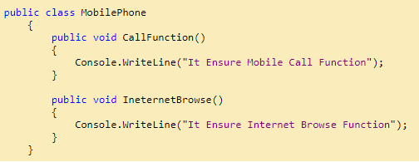
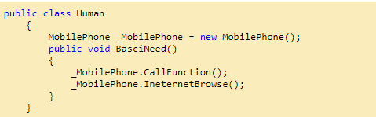
Tight Coupling vs Loose Coupling
If a class directly or concretely has the dependency on another class, then it said to be tightly coupled.
means changing one object required to change another object as well.
It's okay in a small application but in an enterprise-level application, it is too difficult to make the changes.
Loose Coupling
It ensures two objects are independent and the creation of objects outside the class without being dependent on other classes.
DI container helps us by creating an object outside the class and providing it at the right time when we required it so that we don't think about object creation. As a result, our code becomes clean, maintainable and loosely coupled.

Slide 21
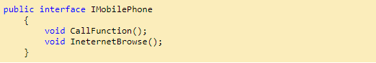
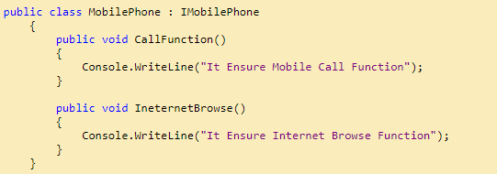
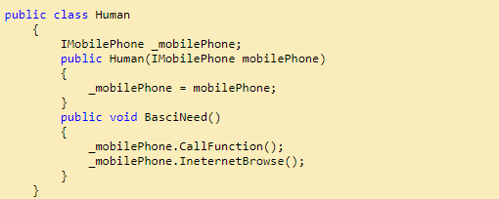
Constructor Injection
Let's see the example using Constructor Injection
DI is served as a service
When we need MobilePhone class object, we just knock the DI container, please give us the expected object. We don't have any worry regarding object creation and changed the existing code as well. DI container will make sure of it.

Slide 22
Service Lifetimes and Registration Options
Singleton:
As the name implies, AddSingleton() method creates a Singleton service.
a Singleton service is created only one time per application and that single instance is used throughout the application life time.
Transient:
This method creates a Transient service.
A new instance of a Transient service is created each time it is requested.
Scoped:
This method creates a Scoped service
A new instance of a Scoped service is created once per request within the scope

Slide 23
What is a View
The View is responsible for rendering the model to the Users.
The Controller in ASP.NET Core applications gets the request. It then executes the appropriate business logic and gets the required data (model). It then delegates the responsibility of rendering the model to the View.
The rendering the data or model is the only responsibility of the View. The Views should not contain any logic and must not do any processing.
The View can use any format to return to the user. The format could be HTML, JSON, XML or any other format for the user to consume as the response to the web request.

Slide 24
Where are View files stored
By default, MVC looks for view files in the Views folder
View files that belong to a specific controller are stored in a sub-folder in the Views folder and that sub-folder has the same name as the controller.
The view file has the same name as that of the controller action method with a .cshtml extension

Slide 25
How to Pass data to view in ASP.NET Core MVC
The One of the ways in which to pass the data to the view is using the ViewData or ViewBag object.
ViewData
The ViewData is a property of the Controller Base class, which returns a ViewDataDictionary object.
The ViewDataDictionary as the name suggests is a dictionary object which allows us to store key-value pairs.
When the View method invoked in the Controller Action method, the ViewData is automatically passed to the View.
In the View, you can access the value stored in the Viewdata using the key.
ViewBag
Viewbag derives from DynamicViewData, so it allows the creation of dynamic properties using dot notation (@ViewBag.SomeKey = <value or object>)
no casting is required
The syntax of ViewBag makes it quicker to add to controllers and views.
The ViewData and ViewBag can pass data from the Controller to View. It cannot be used to pass data from One Controller to another controller.

Slide 26
Strongly Typed View
The view which binds to a specific type of ViewModel instead of dynamic Property
In the strongly typed View, we let the View know the type of ViewModel being passed to it.
The strongly typed Views are created using the@model directive
The @model directive is placed at the top of the view file specifying the type of the ViewModel that is being passed
And then you can refer to the model in the View directly
With Strongly typed view you will get Intellisense help and compile time error checking.
3 | @model Course
3 4 5 6 7 | @{ <p>Id :@Model.Id </p> <p>Name :@Model.NameofCourse </p> <p>Name :@Model.CreditHours</p> }

Slide 27
ViewModel
To pass all of the data that needed from controller to the View
The Model property allows to create the strongly typed Views using the @model directive.
The ViewModel is passed from the Controller to the View either using the ViewBag or ViewData.
ViewModel classes can live anywhere in your ASP.NET Core MVC project, but to keep things better organized, usually place them in a folder that is named ViewModels

Slide 28
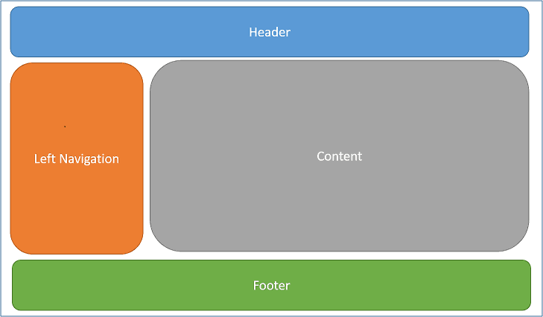
Layouts and Sections in ASP.NET MVC Core
The Layouts and sections in ASP.NET MVC core help us to maintain a consistent look across all the pages or views of our application.
The design of the most websites includes a menu, a header, footer and sidebars.
But the contents of the menu, header, footer, colour schemes do not change. This gives the web pages a consistent look.
The Views folder also contains a shared folder, where views shared across multiple views are shared.
Since layouts are shared across the other views, they are stores in the Views/Shared folder.

Slide 29
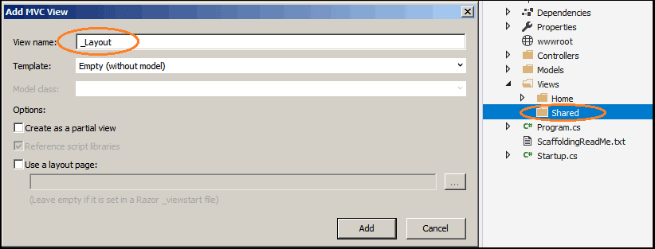
How to Create the Layout Page
Create a folder named Shared under Views folder
Right Click on the Shared folder and click on Add View
Enter the view name as _Layout.
Select the Empty Template and do not select Create as a partial view & Use a layout page as shown in the image below
Click on Add to create the View.

Slide 30
RenderBody and RenderSection
Sections
The ASP.NET Core allows you to create custom sections in the layout pages.
Custom Section expects a name of the section and whether the section is required
The RenderSection(string name, bool required:false) method defines the named section.
Defining the Section in View
The RenderBody is a special method that marks the location where views using this layout will have their content rendered. This basically acts as a placeholder for the Views.
Adding the View and select the Layout Page
1 2 3 4 5 6 7 | @{ Layout = "~/Views/Shared/_Layout.cshtml"; }
1 2 3 | @RenderSection(“test", required: false)
1 2 3 4 5 6 7 8 9 10 11 | @{ Layout = "~/Views/Shared/_Layout.cshtml"; } <p>Here goes the content</p> @section Test { <p>Test Section</p> }

Slide 31
_ViewStart
defining the layout in every view is harder to maintain.
The simpler way is to define the layout in the _ViewStart.html file Adding the View and select the Layout Page
The purpose of the _ViewStart.cshtml is to set up default values to the other Views in the folder and its subfolders.
go to the Views folder and create a view _ViewStart under the folder Views and copy the following code
1 2 3 4 5 6 7 | @{ Layout = "_Layout"; }

Slide 32
EF Core
Entity Framework is an object-relational Mapper(ORM) that allow developers to work with a database using .NET objects.
It allows performing CRUD operations without having to write SQL queries.
NET Core comes with a new version of Entity Framework that is Entity Framework Core
EF core is light weight, cross platform version of Entity Framework
It supports Code First, Database First, Stored Procedure, Transaction, etc.

Slide 33
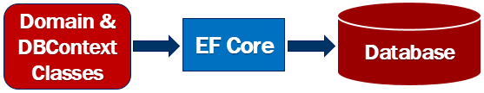
EF Core Code First Approach
EF Core supports both Code First approach and Database First approach.
with the Database First approach there is very limited support in EF core at the moment.
With the Code First Approach, first create the application domain classes like Courses etc and a special class that derives from Entity Framework DbContext class.
Based on the domain and DBContext classes, EF Core creates the database and relevant tables.

Slide 34
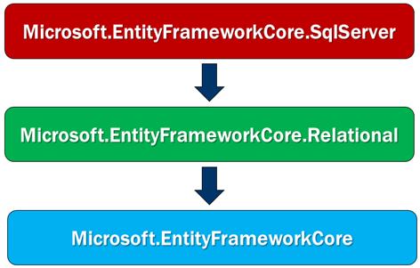
Installation
Package | Purpose
Microsoft.EntityFrameworkCore.SqlServer | This nuget package contains SQL Server specific functionality
Microsoft.EntityFrameworkCore.Relational | This nuget package contains functionality that is common to all relational databases
Microsoft.EntityFrameworkCore | This nuget package contains common entity frameowrk core functionality

Slide 35
DbContext
A class that we use in the application code to interact with the underlying database.
manages the database connection and is used to retrieve and save data in the database.
The DbContext class includes a DbSet<TEntity> property for each entity in the model.
By creating Constructor you can pass the instance DbContext class
1 2 3 4 5 6 7 8 9 10 11 12 13 14 15 16 17 18 19 20 21 22 | public class CourseDbContext :DbContext { public CourseDbContext(DbContextOptions<CourseDbContext> options) : base(options) { } public DbSet<courses> courses { get; set; } }

Slide 36
Using sql server with entity framework core
Entity Framework Core supports a wide variety of databases including non-relational databases
Use AddDbContext() or AddDbContextPool() method to register the application specific DbContext class with the ASP.NET Core dependency injection system
UseSqlServer() extension method is used to configure the application specific DbContext class to use Microsoft SQL Server as the database.
To connect to a database, it needs the database connection string which is provided as a parameter to UseSqlServer() extension method
1 2 3 4 5 6 7 8 9 10 11 12 13 14 15 16 17 18 19 20 21 22 | public class CourseDbContext :DbContext { public CourseDbContext(DbContextOptions<CourseDbContext> options) : base(options) { } public DbSet<courses> courses { get; set; } }

Slide 37
Single-Page Applications

Slide 38
Single-Page Applications
In Multi-Page Applications, the client (browser) which typically sends a request for page to the server to initiates the communication. Then the server processes the request and sends the HTML of the page to the client (browser).
For every request server sends the full html to the client.
In Single-Page Applications (SPAs) at first the entire page is loaded in the client by the initial request, after that the subsequent action has to update by Ajax request and no need to reload the entire page.
The SPA reduces the time by to respond to user actions and result is more fluid experience.

Slide 39
Razor Pages

Slide 40
Razor Pages
ASP.NET Core Razor Pages framework is a new technology to build page-focused web applications quicker and more efficiently with clean separation of concerns.
Razor pages are introduced in .NET Core 2.0. It is lightweight, flexible and provides the developer the full control over the rendered HTML.
In some respects, razor pages are similar to the classic asp.net webforms framework. In ASP.NET Webforms, we have an ASPX page and a code-behind class.
For example, if you have a WebForm with name WebForm1. It's actually a pair of files - WebForm1.aspx (the display template) and WebForm1.aspx.cs (the code-behind class
Similarly, each razor page is also a pair of files - .cshtml and .cshtml.cs
.cshtml - Is the display template. So it contains the HTML and razor syntax.
.cshtml.cs - Contains the server side C# code that handles the page events and provides the data the template needs.

